Slide 1

Orientation to Accreditation
Recovery Training Institute of Alberta

Slide 2
Agenda
What is Accreditation?
Accreditation Canada: Primer & Qmentum
Understanding Standards and ROPs
Steps in the Primer Process
What Happens On-Site?
A Culture of Continuous Readiness
Action Plans, Tracers & Tools
Next Steps for Your Team

Slide 3
CONNECTION BEFORE CONTENT –
Chat with your neighbor ☺
What calls you to this work, and what’s one thing you really care about when it comes to delivering quality care for people in recovery?
What’s something you feel proud of… something you or your team have done that reflects your care or commitment to making recovery services more compassionate, safe, or effective?

Slide 4
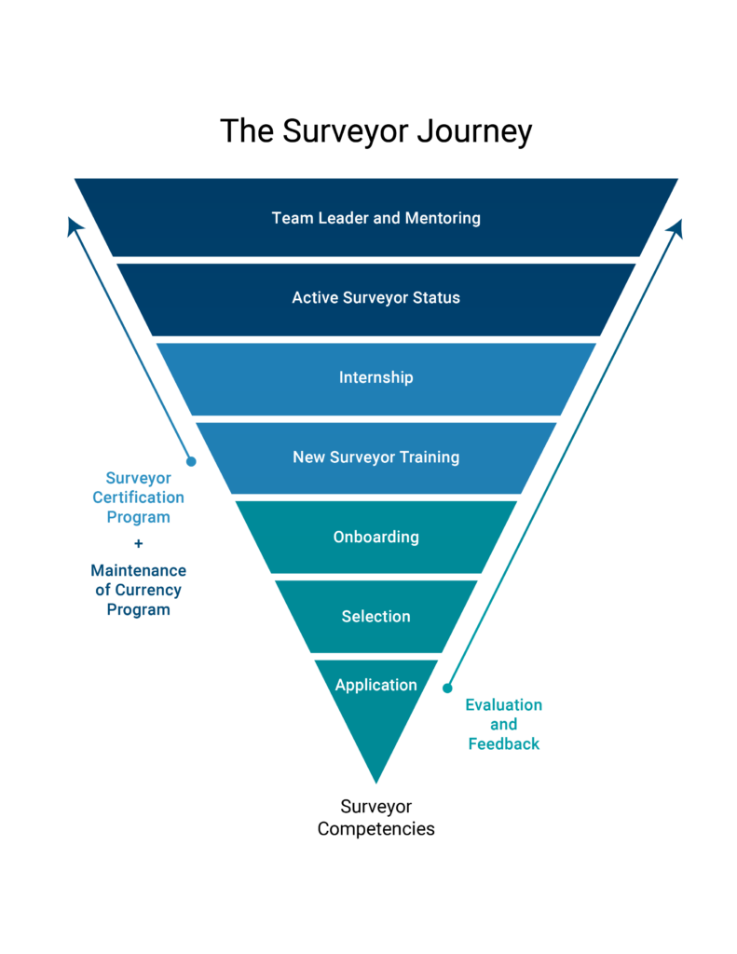
🎤 Ask an Accreditation Surveyor Anything!
(Yes, really—anything)
This is your chance to be curious, bold, or just plain nosy. No question is too small, strange, or specific.
Need inspiration?
“Do surveyors actually talk to staff and clients directly?”
“How can I prepare if I get asked something?”
“What if I don’t know the answer? Is it okay to admit we’re still working on things?”
“Do you actually read all our binders?”
“Are you trained to smell panic when you walk in the building?”
“Has anyone ever tried to bribe you with cupcakes or cookies?”
We're not here to judge—we’re here to help you shine

Slide 5

What is Accreditation?
A process of assessing ourselves against national standards during accreditation surveys.
HSO develops the standards that guide the Accreditation Canada program.
Helps identify areas of excellence and opportunities for improvement.
Accreditation Canada evaluates through Qmentum and the Primer Program.

Slide 6
Accreditation vs. Licensing
 | Alberta Health Licensing | Accreditation (e.g., Accreditation Canada)
 | Mandatory | “Voluntary” – Although may be a requirement for AB Recovery Community Service Providers, check grant.
Purpose | Legal approval to operate health services | Drive quality improvement and excellence
Focus | Safety, staffing, infrastructure, and basic standards | Governance, patient care, safety, and best practices
Authority | Alberta Health | Accreditation Canada (based on HSO standards)
Enforcement | Inspections, compliance reviews, possible license suspension | Peer review, survey results, quality improvement action plans
Key Outcome | Legal operation and regulatory compliance | Recognition of quality and eligibility for funding or contracts

Slide 7
Primer vs. Qmentum
Primer: Foundational step for new organizations.
Qmentum: Full accreditation program focused on ongoing improvement.
Organizations usually move to Qmentum within 2 years of Primer success.

Slide 8
Primer Process Overview
Step 1: Designate Accreditation Coordinator & Access Portal
Step 2: Conduct Self-Assessment
Step 3: Analyze Results & Build Action Plan
Step 4: On-Site Survey
Step 5: Decision & Transition to Qmentum

Slide 9
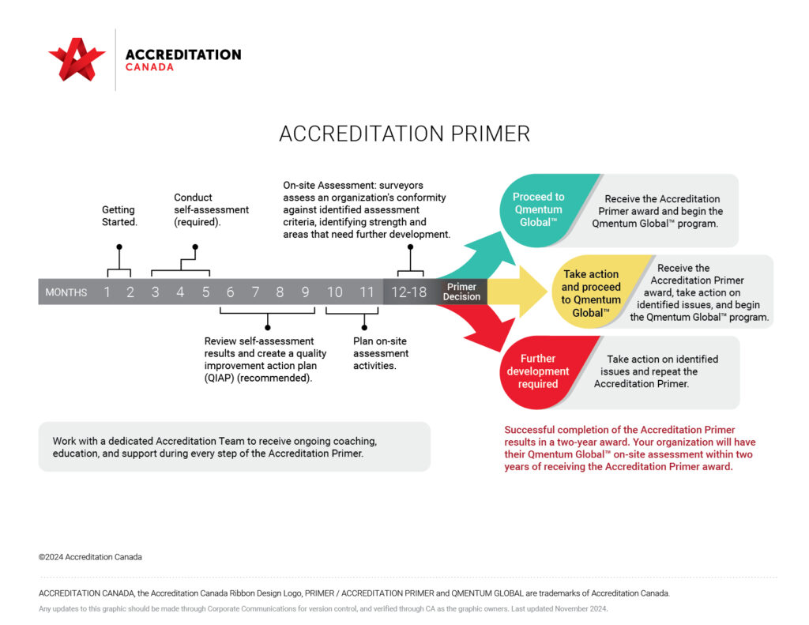

Slide 10

What are
Standards & ROPs?
Over 100 standards. A few recent relevant additions, Indigenous Health and Cultural Safety and Humility Standard to National Standard
ROP Examples: Medication Reconciliation, Infection Control, Fall Prevention.
Compliance is required for Accreditation status – the non-negoriables!

Slide 11
A recent shift to Continuous Readiness
Shift occurred in 2023 for Qmentum Global
Accreditation is no longer a one-time event.
Embed accountability, standards and ROPs into daily routines.
Use committees and daily huddles to drive quality & leadership

Slide 12
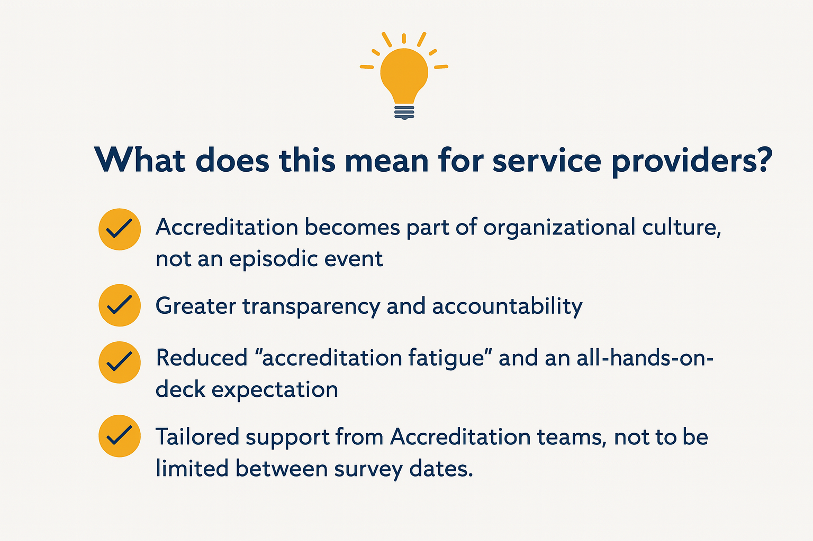
So
WHAT?
NOW WHAT?

Slide 13
Action Planning after Self-Assessment
Review red/yellow flagged items.
Set SMART goals (Specific, Measurable, Achievable, Relevant, Timely).
Assign responsibilities and timelines.
Monitor progress and adapt as needed.

Slide 14
What Happens During the On-Site Survey?
Introductory meeting with leadership.
Discussion groups, interviews, document reviews.
Tracers to follow the path of care.
Leadership and general debriefings.

Slide 15
The Tracer Methodology
Surveyors follow a patient or process from start to finish.
Observations, interviews, and record reviews in real-time.
Evaluates how well quality and safety are integrated.

Slide 16
IF YOU ARE ALREADY SIGNED Up –
Reflect on your Plan for CONTINUOUS READINESS
FUN ☺
Make it Fun – Celebrate learning and improvement.
CONSISTENCY
Be Consistent – Embed standards in everyday work.
STRENGTH-FOCUSED
Leverage Strengths – Use existing structures.
PERSON-CENTRED
Involve Clients & Families – Embed person-centred care.
ACTION-ORIENTED
Take Action – Mock tracers, evidence review, self-assessments.

Slide 17
If you are not signed up yet - consider Next Steps for Your Team
Confirm readiness, resources, and assign a lead to establish your Primer Team.
1
Access your organization portal and set up your profile.
2
Plan and complete your self-assessment.
3
Prepare for the on-site survey using the Primer Manual.
4
Engage in continuous improvement through your ACR Plan.
5

Slide 18

Team Activity!
Our Accreditation Metaphor

Slide 19
Questions & Discussion
What excites you about this journey?
What supports or tools do you need to get started?
Let’s talk logistics, barriers, and opportunities!

