Slide 1

Addiction as Self-Medication
What Problem is the Addiction Solving?
Carrie DeJong, MC, RCC

Slide 2
What might people be trying to escape, soothe, numb, or change?

Slide 3
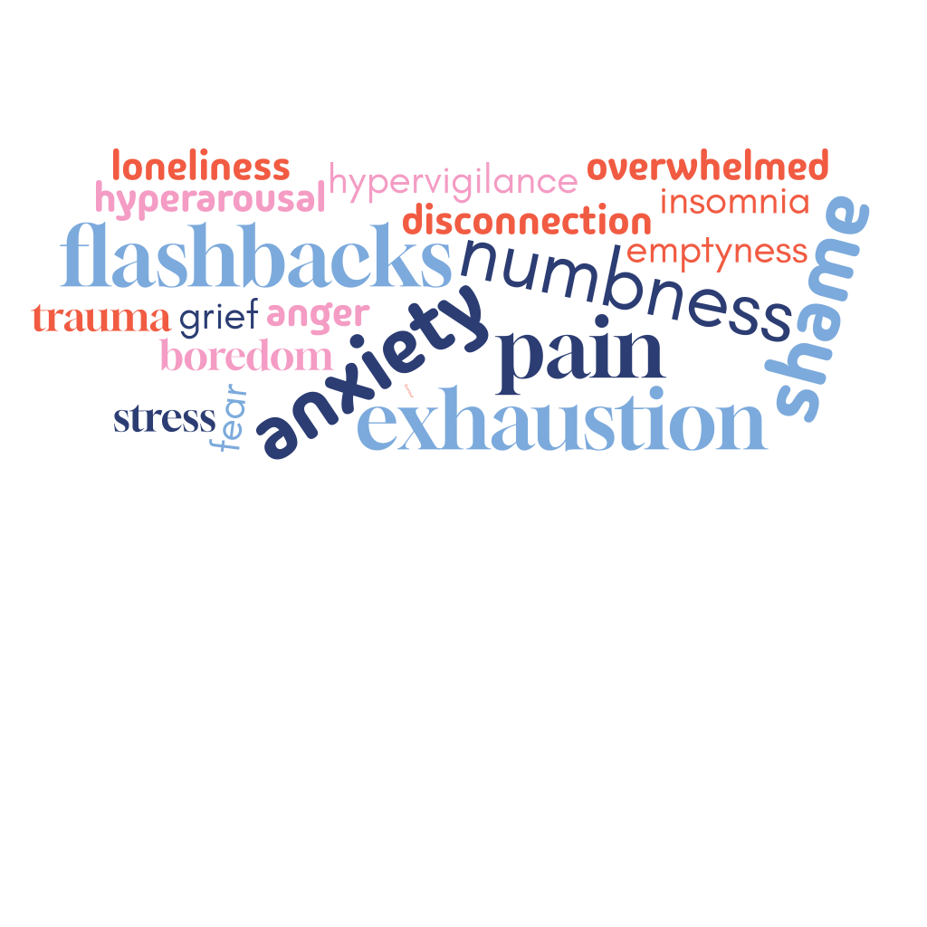
What might people be trying to escape, soothe, numb, or change?

Slide 4
What might people be trying to escape, soothe, numb, or change?
Relief often becomes more important than pleasure.

Slide 5
Curiosity Instead of Judgement
Judgment
Why can’t they stop?
Why do they keep relapsing?
Why do they make poor choices?
Why don’t they use coping tools?

Slide 6
Curiosity Instead of Judgement
Judgment
Curiosity
Why can’t they stop?
Why do they keep relapsing?
Why do they make poor choices?
Why don’t they use coping tools?
What relief did they find in using?
What became overwhelming?
What pain were they carrying?
What hijacked their thinking?

Slide 7
Questions That Open Recovery Conversations
  What was happening before the use?
  What did the substance or behaviour help with?
  What became more manageable after using?
  What might need support now that the substance is gone?

Slide 8
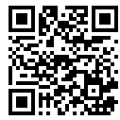
My website has more articles about trauma and addiction.
www.carriedejong.com

